Slide 1

NASA Carbon Monitoring System
J. A. Kaye, B. Doorn, K. W. Jucks, D. E. Wickland, and P. S. Bontempi
Earth Science Division
Science Mission Directorate
NASA Headquarters
October 5, 2011

Slide 2
NASA CMS Plan Overview
NASA plans to generate, distribute, and evaluate two pilot products and carry out one scoping study:
  Terrestrial Biomass Pilot Product
    Utilizing satellite and in situ data, produce quantitative estimates (and uncertainties) of aboveground terrestrial vegetation biomass (for U.S. and local scale)
    Assess the ability of these results to meet the nation’s need for monitoring carbon storage / sequestration.
  Integrated Emission/Uptake (Flux) Pilot Product
    Combine satellite data with modeled atmospheric transport initiated by observationally-constrained terrestrial and oceanic models to tie the atmospheric observations to surface exchange processes.
    Estimate the atmosphere-biosphere CO₂ exchange
  Scoping Study
    Identify research, products, and analysis system evolutions required to support carbon policy and management as global observing capability increases

Slide 3
Relation to Congressional Direction
FY10 Appropriation Direction: “Also included within the funds provided for other mission and data analysis, the conference agreement provides $6,000,000 for pre-phase A and pilot initiatives for the development of a carbon monitoring system. Any pilot developed shall replicate state and national carbon and biomass inventory processes that provide statistical precision and accuracy with geospatially explicit associated attribute data for aggregation at the project, county, state and federal level using a common dataset with complete market transparency, including extraction algorithms and correlation modeling.”
President’s FY11-15 request supported a sustained CMS effort:
  “The FY2011 budget request will provide for continuation and growth of the Carbon Monitoring System activity begun in FY2010 to provide an improving set of products on carbon storage and exchange between the surface and biosphere for regular delivery to policy and decision-makers, as well as for observing system simulation experiments designed to facilitate development of future carbon monitoring observational capability. This investment leverages the much larger underlying NASA program in Carbon Cycle science.” This all changed in the actual appropriations….no CMS reference at all.
  Same thing may happen in FY2012 budget process.

Slide 4
NASA’s Goals and Principles in its Approach to CMS
Make significant contributions in characterizing, quantifying, understanding, and predicting the evolution of global carbon sources and sinks
Use the full range of NASA satellite observations and modeling/analysis capabilities to establish the accuracy, quantitative uncertainties, and utility of products for supporting national and international policy, regulatory, and management activities
  Maintain global emphasis while providing finer scale regional information, utilizing space-based and surface-based/in situ data
  Develop evolutionary approach accommodating planned increasing capabilities in space-based measurements, modeling, and data assimilation
  Harness unique capabilities of NASA centers and the NASA-funded investigator community, making use of competitive peer review wherever possible
  Continue to engage with, and contribute to, related U.S. and international systems
  Rapidly initiate generation and distribution of products, both for evaluation and to inform near-term policy development and planning

Slide 5
Terrestrial Biomass Pilot Project: Overarching Goals and Objectives
Goal: Provide geospatially explicit, consistent estimates of aboveground terrestrial vegetation biomass and carbon storage for the U.S. by combining advanced satellite products with ground observations and evaluate how well these estimates meet the nation’s need for monitoring carbon storage and changes in carbon storage.
Objectives:
Develop prototype data products of national biomass (and carbon storage/change) that can be assessed with respect to how they meet the nation’s need for monitoring (also reporting and verification) of carbon inventories.
Demonstrate our readiness to produce a consistent biomass/carbon stock distribution using the existing in situ and satellite observations to meet monitoring (MRV) requirements.
Evaluate how well carbon stocks and fluxes can be quantified at the management scale (project-, county-, state-level) using remote sensing data sources not currently available from space (primarily airborne lidar)

Slide 6
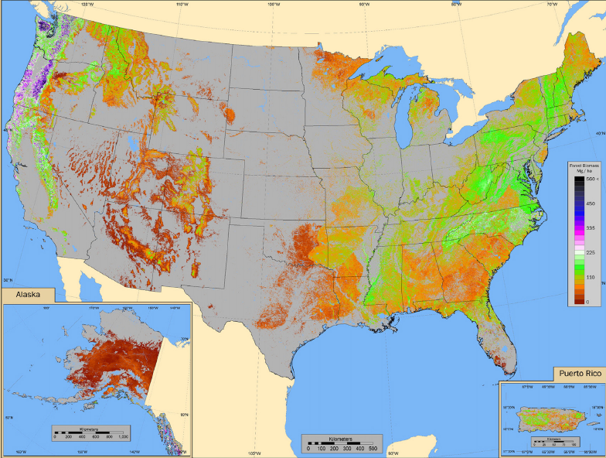
National Biomass and Carbon Storage
Estimating Biomass and Carbon Storage by Combining
Satellite and Ground Observations
National Data Processing Activities
Development of Methodology
Regional Results and Products
Validation and Uncertainty Analysis
NASA Center Leads:
Sassan Saatchi (JPL)
Rama Nemani (ARC)
Compton Tucker, Jeff Masek (GSFC)
Co-investigators:
Richard Birdsey (USDA/FS)
Michael Lefsky (CSU)
Project Domain

Slide 7
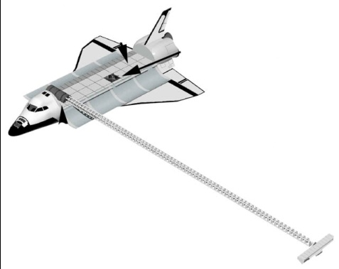
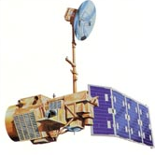
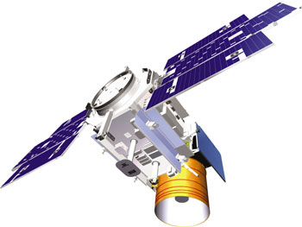
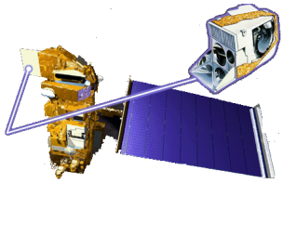
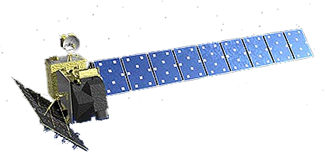
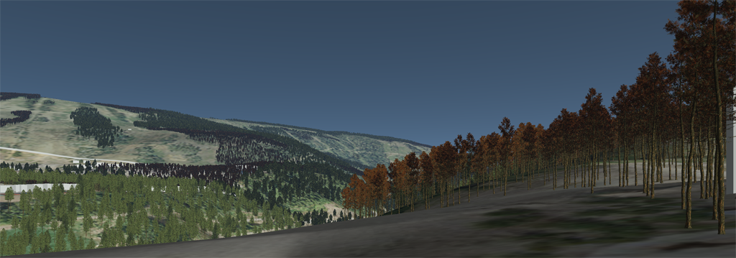
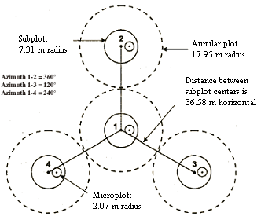
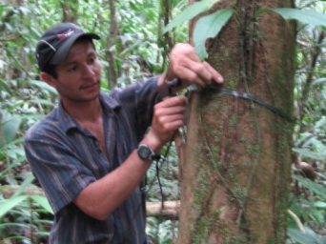
Satellite and In Situ Observations
SRTM
ICESat
MODIS
ALOS PALSAR
LANDSAT
USDA FS, FIA Data

Slide 8
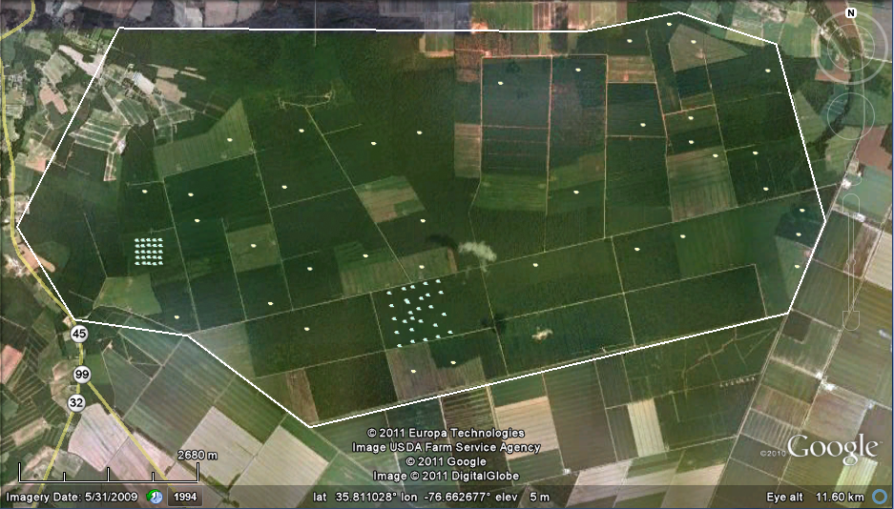
Carbon Stocks and Fluxes at the Local Scale
1. Develop protocols for computing terrestrial biomass density and associated errors from a combination of active and passive remotely sensed data at fine spatial scales (1 ha).
2. Create high-spatial resolution maps of biomass and carbon flux for study sites
    Include all live, above-ground biomass
    Fluxes to include above- and below-ground components (e.g., NPP, Rh)
3. Evaluate our ability to detect biomass change using Landsat disturbance products and repeat-pass radar/lidar instruments.
4. Assist validation of national biomass map.
Compton Tucker (PI), Jeff Masek, Bruce Cook (NASA-GSFC)
Ralph Dubayah, George Hurtt (U. Maryland)
Sigma Space, GeoDigital, SGT and others. . .

Slide 9
The CMS Flux Pilot Project is a collaboration among NASA Centers (GSFC, JPL, ARC) to derive and evaluate carbon fluxes using satellite observations in conjunction with the MERRA analyses
Atmospheric Meteorology and Transport from GEOS-5/MERRA analyses:
Physical constraints on bottom-up CO₂ fluxes
High-resolution forward model ensembles
Inversion: adjoint approach for top-down fluxes
Evaluation and Assessment:
Comparison of bottom-up flux estimates with existing independent data
Comparison of CO₂ values in forward-model ensembles to observations (in-situ, space-based)
Comparison of inverse estimate to bottom-up fluxes (used as priors) and other data
Fossil-Fuel and Biofuel CO₂ Flux Inventories
Land CO₂ Fluxes: GSFC
CASA/GFED & ARC NASA/CASA
Biomass Burning CO₂ Fluxes: GFED3
Ocean CO₂ Fluxes:
NOBM and ECCO2
All components use a variety of NASA’s satellite observations
ACOS retrievals of X_{CO2} from GOSAT are the basis of the inversion study
Initial focus on July 2009-June 2010 – first year of GOSAT observations

Slide 10
Model components used in the CMS Flux Pilot Project, indicating the purpose of the model, the data constraints used and the institutional leaders of each component
CASA (ARC – Potter):
Biophysical land carbon fluxes using satellite-data (MODIS) and meteorological (MERRA) constraints
CASA/GFED3 (GSFC – Collatz):
Biomass-burning emissions estimates with data constraints (MODIS, etc.)
Biophysical land carbon fluxes using satellite data (MODIS) and meteorological (MERRA) constraints
ECCO2 (JPL – Menemenlis, collaborating with MIT – Hill)
Ocean carbon fluxes using a data-constrained physical ocean model and a self-organizing marine ecosystem model
NOBM (GSFC – Gregg):
Physical/Biogeochemical ocean carbon fluxes using GEOS-5-constrained physical ocean model and observation-constrained (SeaWiFS, MODIS) biogeochemistry
GEOS-5 GCM (GSFC – Ott):
MERRA-constrained ensembles of atmospheric CO₂ (fluxes and transport perturbed)
GEOS-CHEM (JPL – Bowman):
Adjoint of GEOS-Chem transport core (from GEOS-5) used in top-down inversion

Slide 11
Goals for the Year that is ending
1. Compute bottom-up and top-down fluxes using the satellite-data constrained models
2. Compute these fluxes for one year (July 2009-June 2010), using ACOS/GOSAT retrievals of atmospheric CO₂ concentrations
3. Start to evaluate and assess the computed fluxes … (and improve them)

Slide 12
Scoping Study
The scoping study will provide a strategic plan for identifying how NASA will coordinate and support carbon policy and carbon management decisions (e.g., treaty verification, adaptation at local and regional scales)
Identify what products (with associated resolution and quality) can be provided over time, especially as observing system increases as outlined in NASA Climate Initiative (OCO-2, ICESat II, DESDynI-Radar, PACE, ASCENDS)
Examine how modeling and assimilation programs can be best positioned to benefit from the new observing capability, what additional data (ground, airborne) are needed to complement, and what types of computational and data delivery systems are needed to fully capitalize on new observational capability
Use systems engineering capability of NASA, as well as competitive approach to bring in expertise of outside community (particularly private sector)

Slide 13
Other CMS Activities
Additional ROSES Selections to advance CMS goals and/or exploratory studies where research investments now may lead to new knowledge / capabilities for carbon monitoring – for example, for ocean carbon sources and sinks
Augmented in situ measurement and calibration/validation infrastructure in support of carbon monitoring

Slide 14
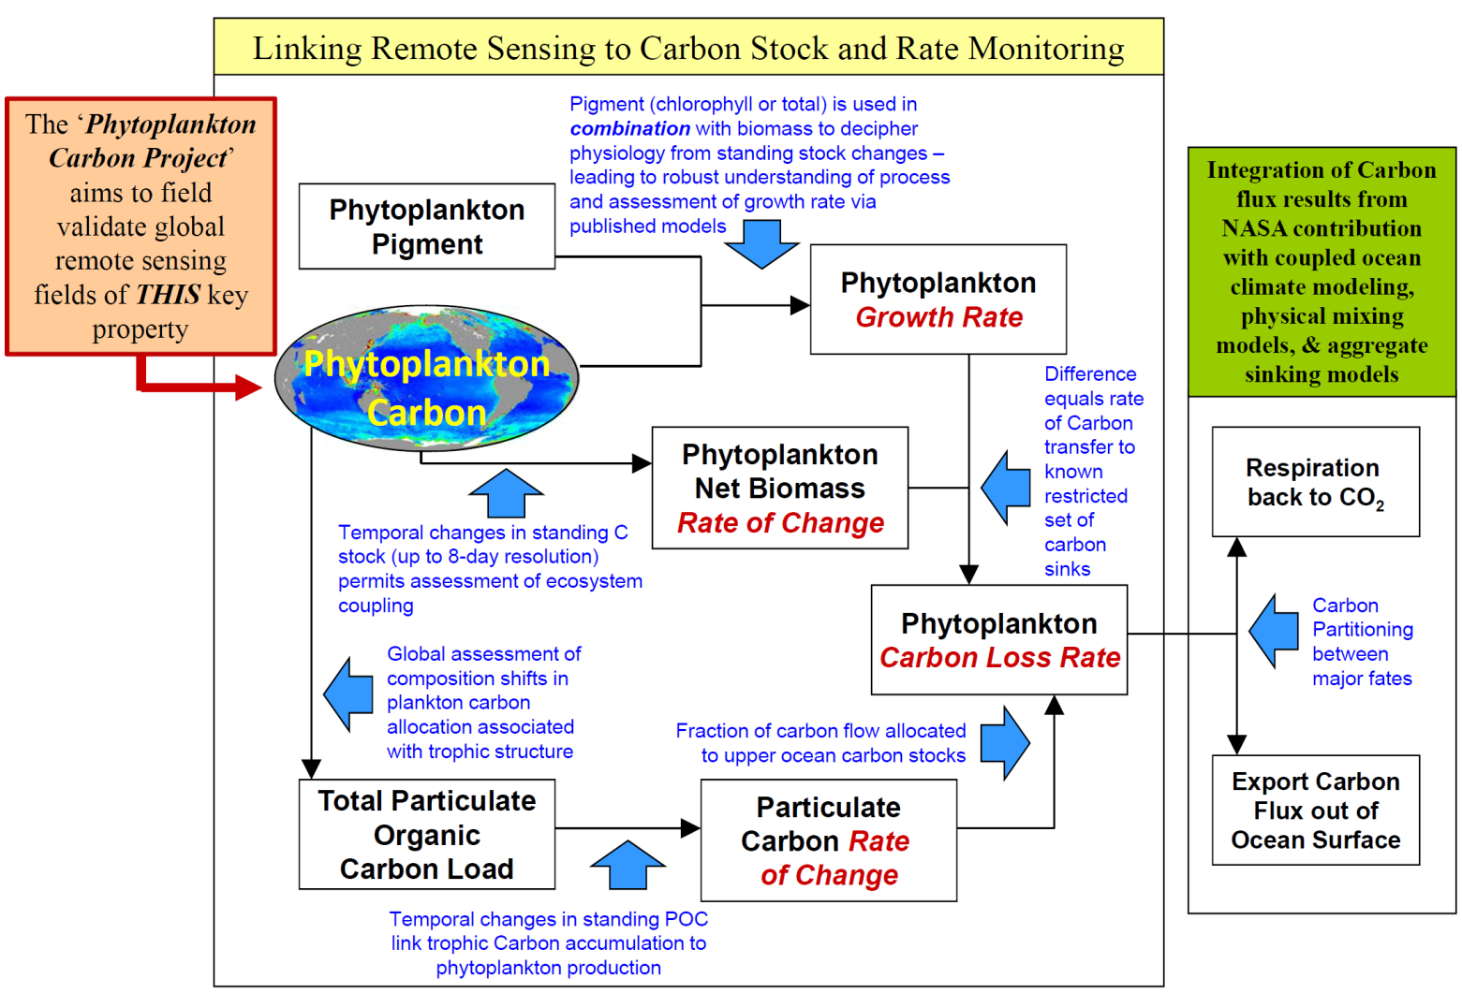
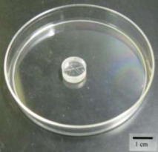
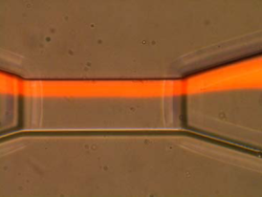
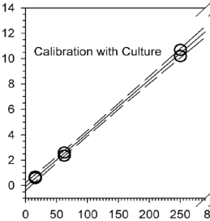
‘The Phytoplankton Carbon Project’
Context: NASA’s Earth System Satellites allow assessment and monitory of key ocean carbon stocks and rates and, when combined with models, allow assessments of CO₂ sinks and sources.
Issue: Phytoplankton biomass is central to a carbon monitoring scheme, but is still unvalidated
Project Scope: Parallel development to two field-deployable phytoplankton biomass measurements
Approach #1: Provide full particle size spectrum (0.1 – 50 um), particle volume, and pigment detection
Approach #2: Direct analytical carbon measurement has detection limit of 5 to 10 phytoplankton cells (size dependent)

Slide 15
CMS: Progress to Date
Identified two pilot studies (integrated emission/uptake (flux), and biomass) and a scoping study and organized NASA centers to develop and implement efforts needed for near-term deliverables
Assessed near-term investment opportunities for exploratory research and hardware that could serve to provide underpinnings and/or validation of products provided and funded them
Held investigator workshop on scoping study July 13-14, 2010
Solicited and selected a CMS Science Definition Team (SDT) to provide guidance for and assistance with the initial pilot products
  SDT met with NASA Center teams in March and September, 2011
  SDT also met separately with biomass (June) and flux (July) teams
Initial versions of biomass and flux products will be completed by end of 2011. Evaluation and documentation of uncertainties will continue into 2012.
Augmented evaluation and prototyping for next phases has been funded at the NASA Centers through 2012.

Slide 16
CMS Science Definition Team
Ave Arellano, University of Arizona
Molly Brown, NASA GSFC
Nancy French, Michigan Tech
Susan Healy, US Forest Service
Richard Houghton, Woods Hole
Eric Kasischke, U Maryland
Josef Kellndorfer, Woods Hole
Molly Macauley, Resources for the Future
Anna Michalak, University of Michigan/Stanford
Hank Shugart, U. Virginia
Gouging Sun, University of Maryland
Robert Treuhaft, JPL
Curtis Woodcock, Boston U.
Jingfeng Xiao, U. New Hampshire
→ In addition, Randy Kawa, NASA GSFC and Annmarie Eldering, JPL added to NASA Center CMS Flux Pilot Project Team

Slide 17
Biomass Work Plan for 2012
Complete Validation/ Uncertainty Analysis of National Biomass Product (Oct 2011 – Mar 2012)
  Holdout FIA measurements & effects of aggregation
  National comparison with local products
  Component-level error model
  “Sampling” vs. error @ local scale
  Make final data, metadata, and algorithms available
Joint Uncertainty Analysis Between Lidar and FIA Data
Prototype Biomass Change Methodologies (Jan – Sep, 2012)
  Regional-scale (e.g. Northeastern US)
  Local-scale (1 site within Region)

Slide 18
Flux Work Plan for 2012
Assess interannual, seasonal and synoptic variations in flux estimates
use satellite observations, MERRA constraints, perform atmospheric forward model computations to map between fluxes and concentrations for validation
Provide estimates of system uncertainty
model state, observational error, transport uncertainty, error propagation
Estimate accuracy and realism of the inversion fluxes
extend to July 2009 - June 2011, formal estimates of uncertainty, examine sensitivities in the adjoint system, evaluate priors, independent estimates; use with TES as well as GOSAT, etc.

Slide 19
Next Steps for Carbon Monitoring System
Monitor progress on pilot projects and provide status
Make products available for further assessment and use
Conduct follow-on scoping study activities (likely including second community workshop with scope and focus still to be determined)
Develop and release a solicitation for community participation in next phases of CMS, taking into account any Congressional direction that may be received
  Consider and implement plans for follow-on to existing pilot projects
  Take into account guidance from CMS SDT regarding future directions
  Pay particular attention to oceanic elements of a carbon monitoring system
Regularly engage in interagency coordination through existing (e.g., USGCRP CCIWG) and evolving interagency mechanisms to assure good coordination with related efforts of other agencies
Notes:
The report identified critical actions and priorities that the science community feels need to be addressed to move the carbon research toward carbon products that can be systematically used by policy/management organizations. The science community clearly identifies terrrestrial biomass maps and exploitation of lidar as clear priorities. Atmospheric effort need to address the key “emission” issue; that is urban centers. Furthermore, the ocean community concluded that as with systematic flux maps we need to focus on the Land-Ocean carbon exchange issues.
The report is posted on our Carbon Cycle and Ecosystems website.

Slide 20

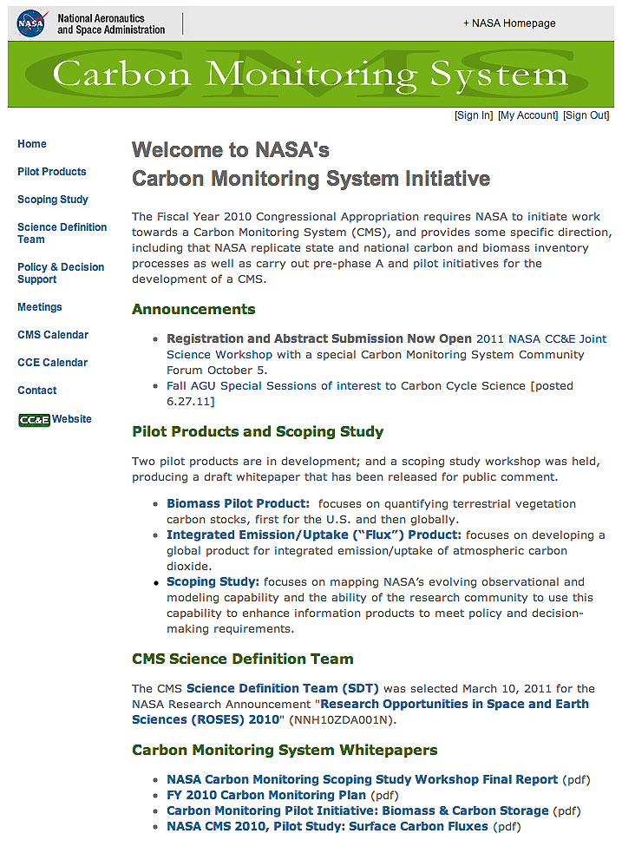
carbon.nasa.gov
Information, Announcements, and Documents regarding the NASA Carbon Monitoring System can be found on this Web site – there is also a link to it off the CC&E Web site (in the list of programs on the left).
http://carbon.nasa.gov
Notes:
NEW Carbon Monitoring System Web site

Slide 21
Thank you

